Slide 1
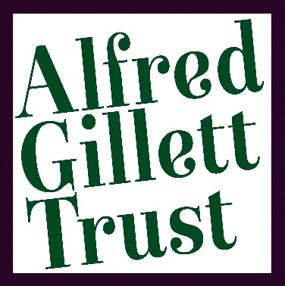
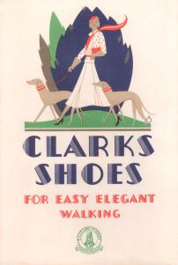
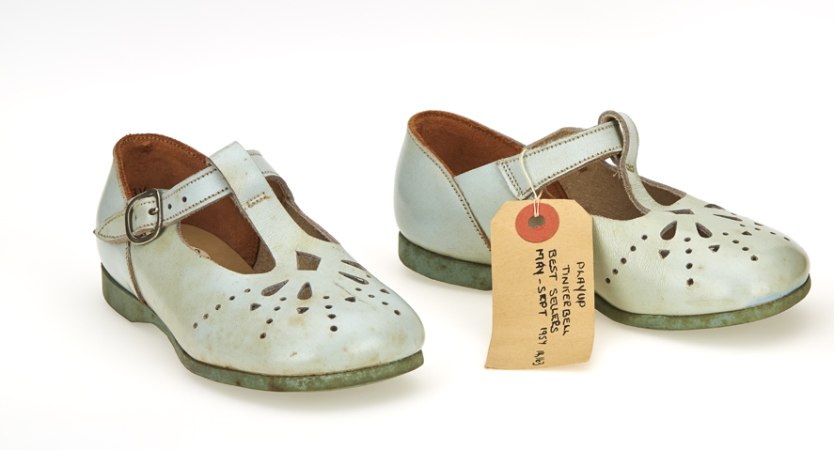
THE ALFRED GILLETT TRUST
BRAND DESIGN
COMPETITION
Notes:
Hi and Welcome!!
Thank you all for coming! We are excited to have the chance to welcome you to the Grange – which, in itself has a fascinating history. We will get a chance to share some of wonderful history with you whilst we give you tours of the grounds.
We have launched this competition to find an up and coming, creative design force to create a fresh, focused and innovative new brand for the Trust. This will help us engage with our audiences and increase visibility of the Trust.

Slide 2
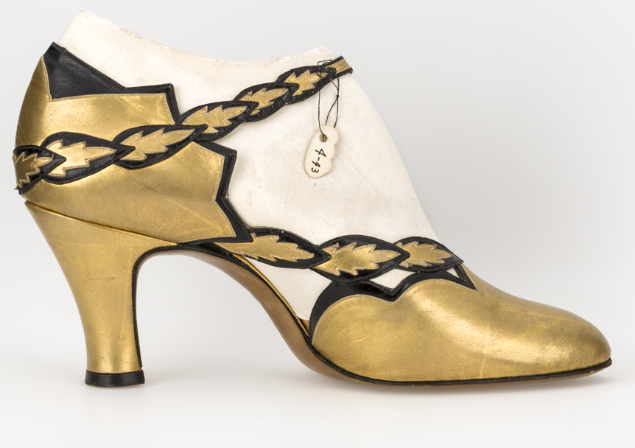
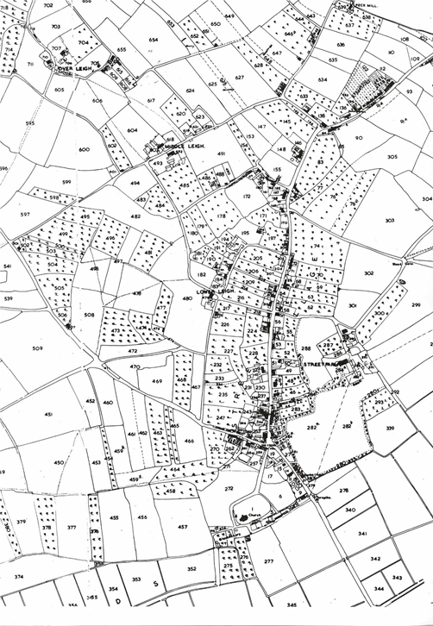
PLAN OF WHAT’S TO COME
Who we are
What we do
Brand development
The Brief
Insight into Clarks branding through their point of sale collection
Our current branding
What we like
Notes:
So we are going to share with you this evening the important bits; a background of the Alfred Gillett Trust, who we are, and what we do, the brief and a whirlwind tour of branding in museums, and commercial companies; having a look at Clarks and in detail one of the collections we have here. We also want to show what the team here, likes in terms of museum branding.

Slide 3
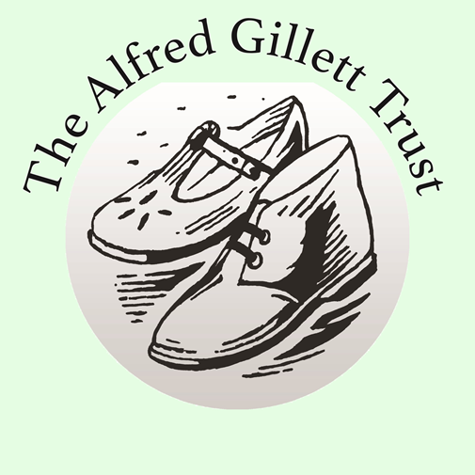
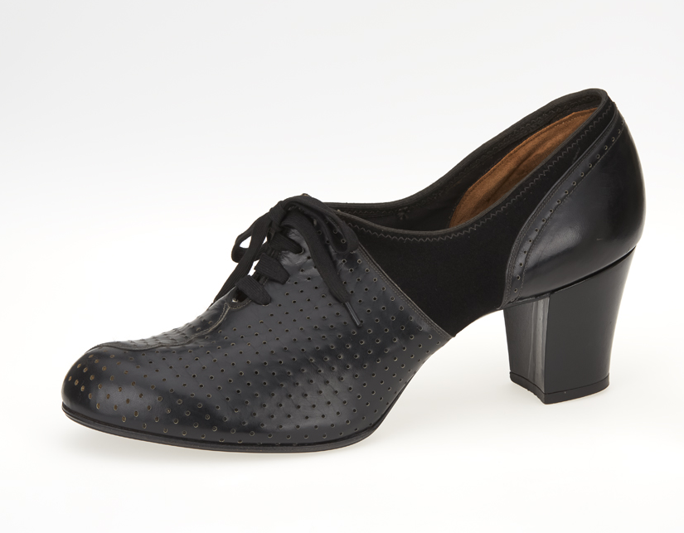
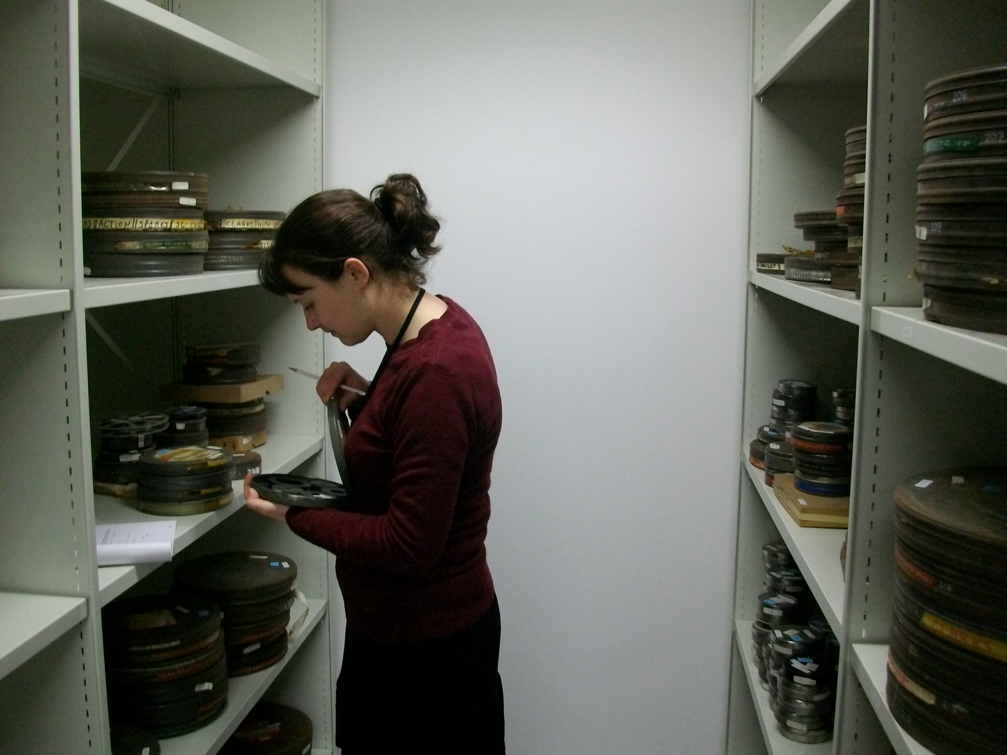
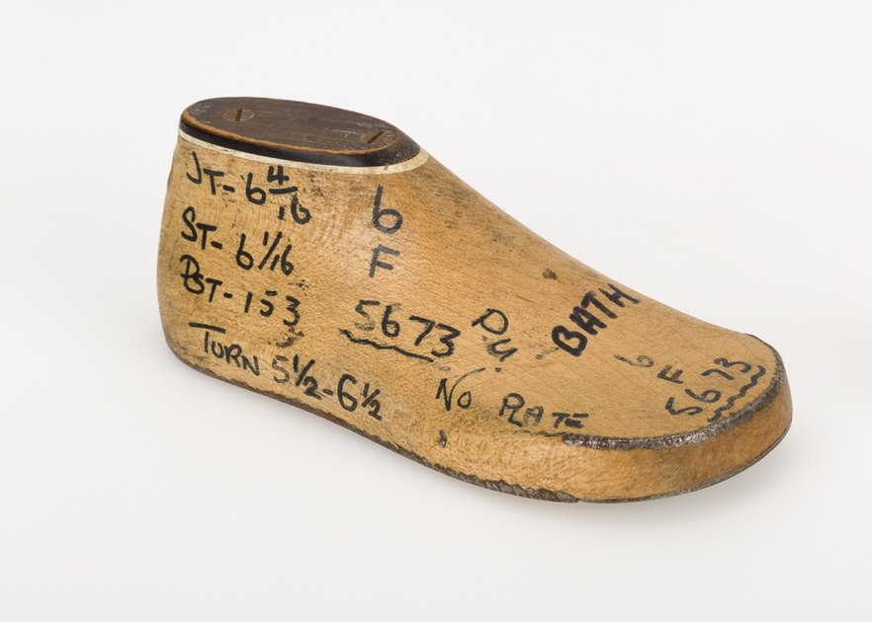
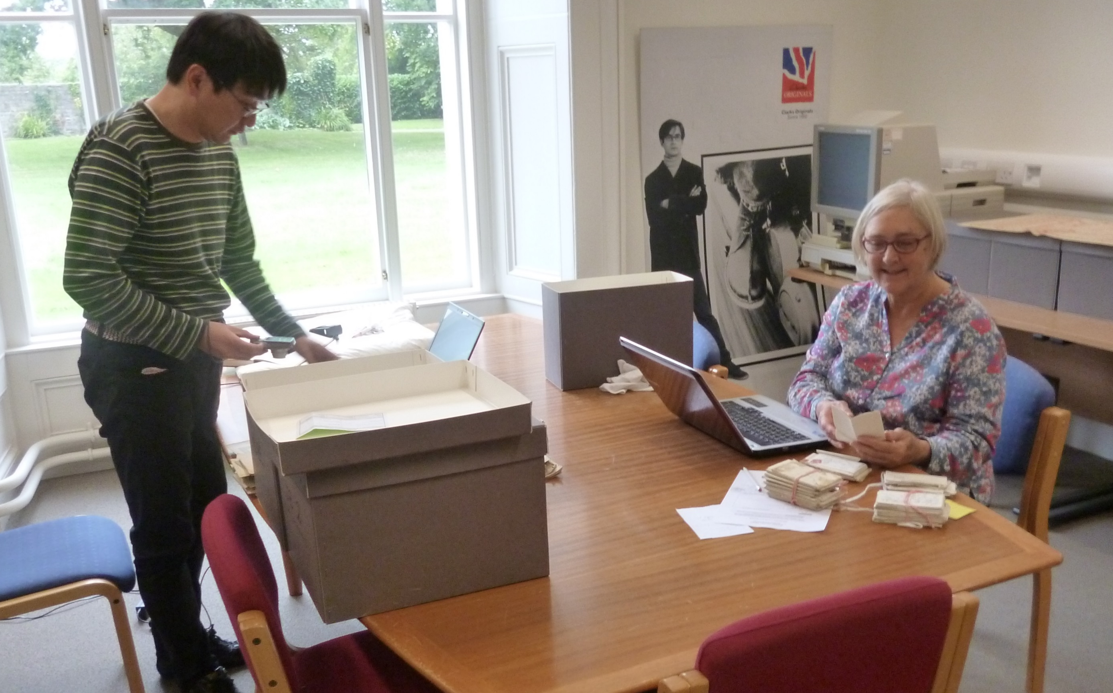
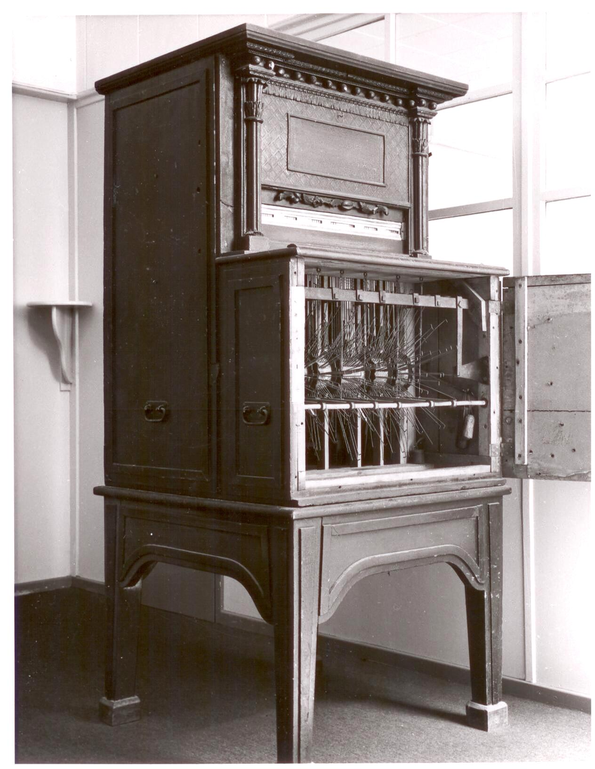
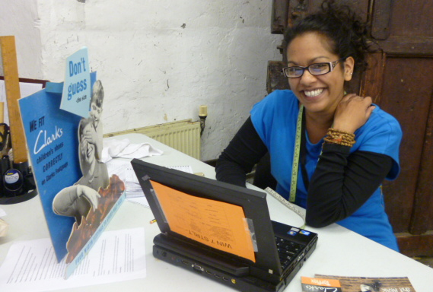
ABOUT US
WHO ARE WE?
WHAT DO WE DO?
Notes:
Right.. So who are we? And what do we actually do?
The Alfred Gillett Trust was established in 2002, by Richard Clark, the son of Bancroft Clark. We care for the heritage collections of C&J Clark Ltd and the Clark family.
The Clark family established the globally-recognised shoe company founded in 1825.
The charity is housed in this historic Grade II listed Grange building in the heart of Street.
We not only have researchers from the company, but also researchers from around the world come to explore the collections.
And if you’re wondering who Alfred Gillett was. His mother was a cousin of Cyrus and James Clark, and a great collector of fossils.

Slide 4
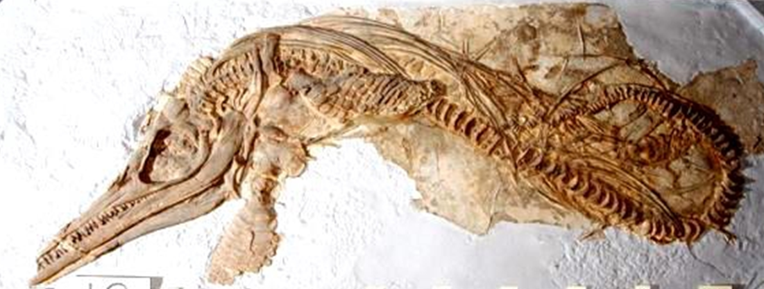
ABOUT US
THE COLLECTIONS:
FAMILY AND BUSINESS –
Photographs, fossils, artwork, furniture, costume, audio visual, point of sale, shoe catalogues, historic shoes, shoe making machinery,
Notes:
We are extremely lucky to have such varied collections in our care and include shoe catalogues, point of sale materials, fossils, artwork, furniture, costume, photographs, film and sound archives, a large collection of historic shoes and contemporary footwear, shoe making machinery and archival material.

Slide 5
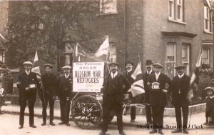
OUR MISSION
Our Mission is to share the rich history of Street’s shoe industry, demonstrating the principles of stewardship, integrity and community-mindedness, upon which the collection was founded, and inspiring the next generation of creators, thinkers and innovators.
Notes:
Our mission and vision statements form the core of what we do and inform where we go next. They are intended for short term use until the new museum is delivered where they will then be adapted, but it’s a good starting point.
Our mission is to share the rich history of Street’s shoe industry, demonstrating the principles of stewardship, integrity and community mindedness, upon which the collection was founded, and inspiring the next generation of creators, thinkers and inventors. … Not too much pressure then!

Slide 6
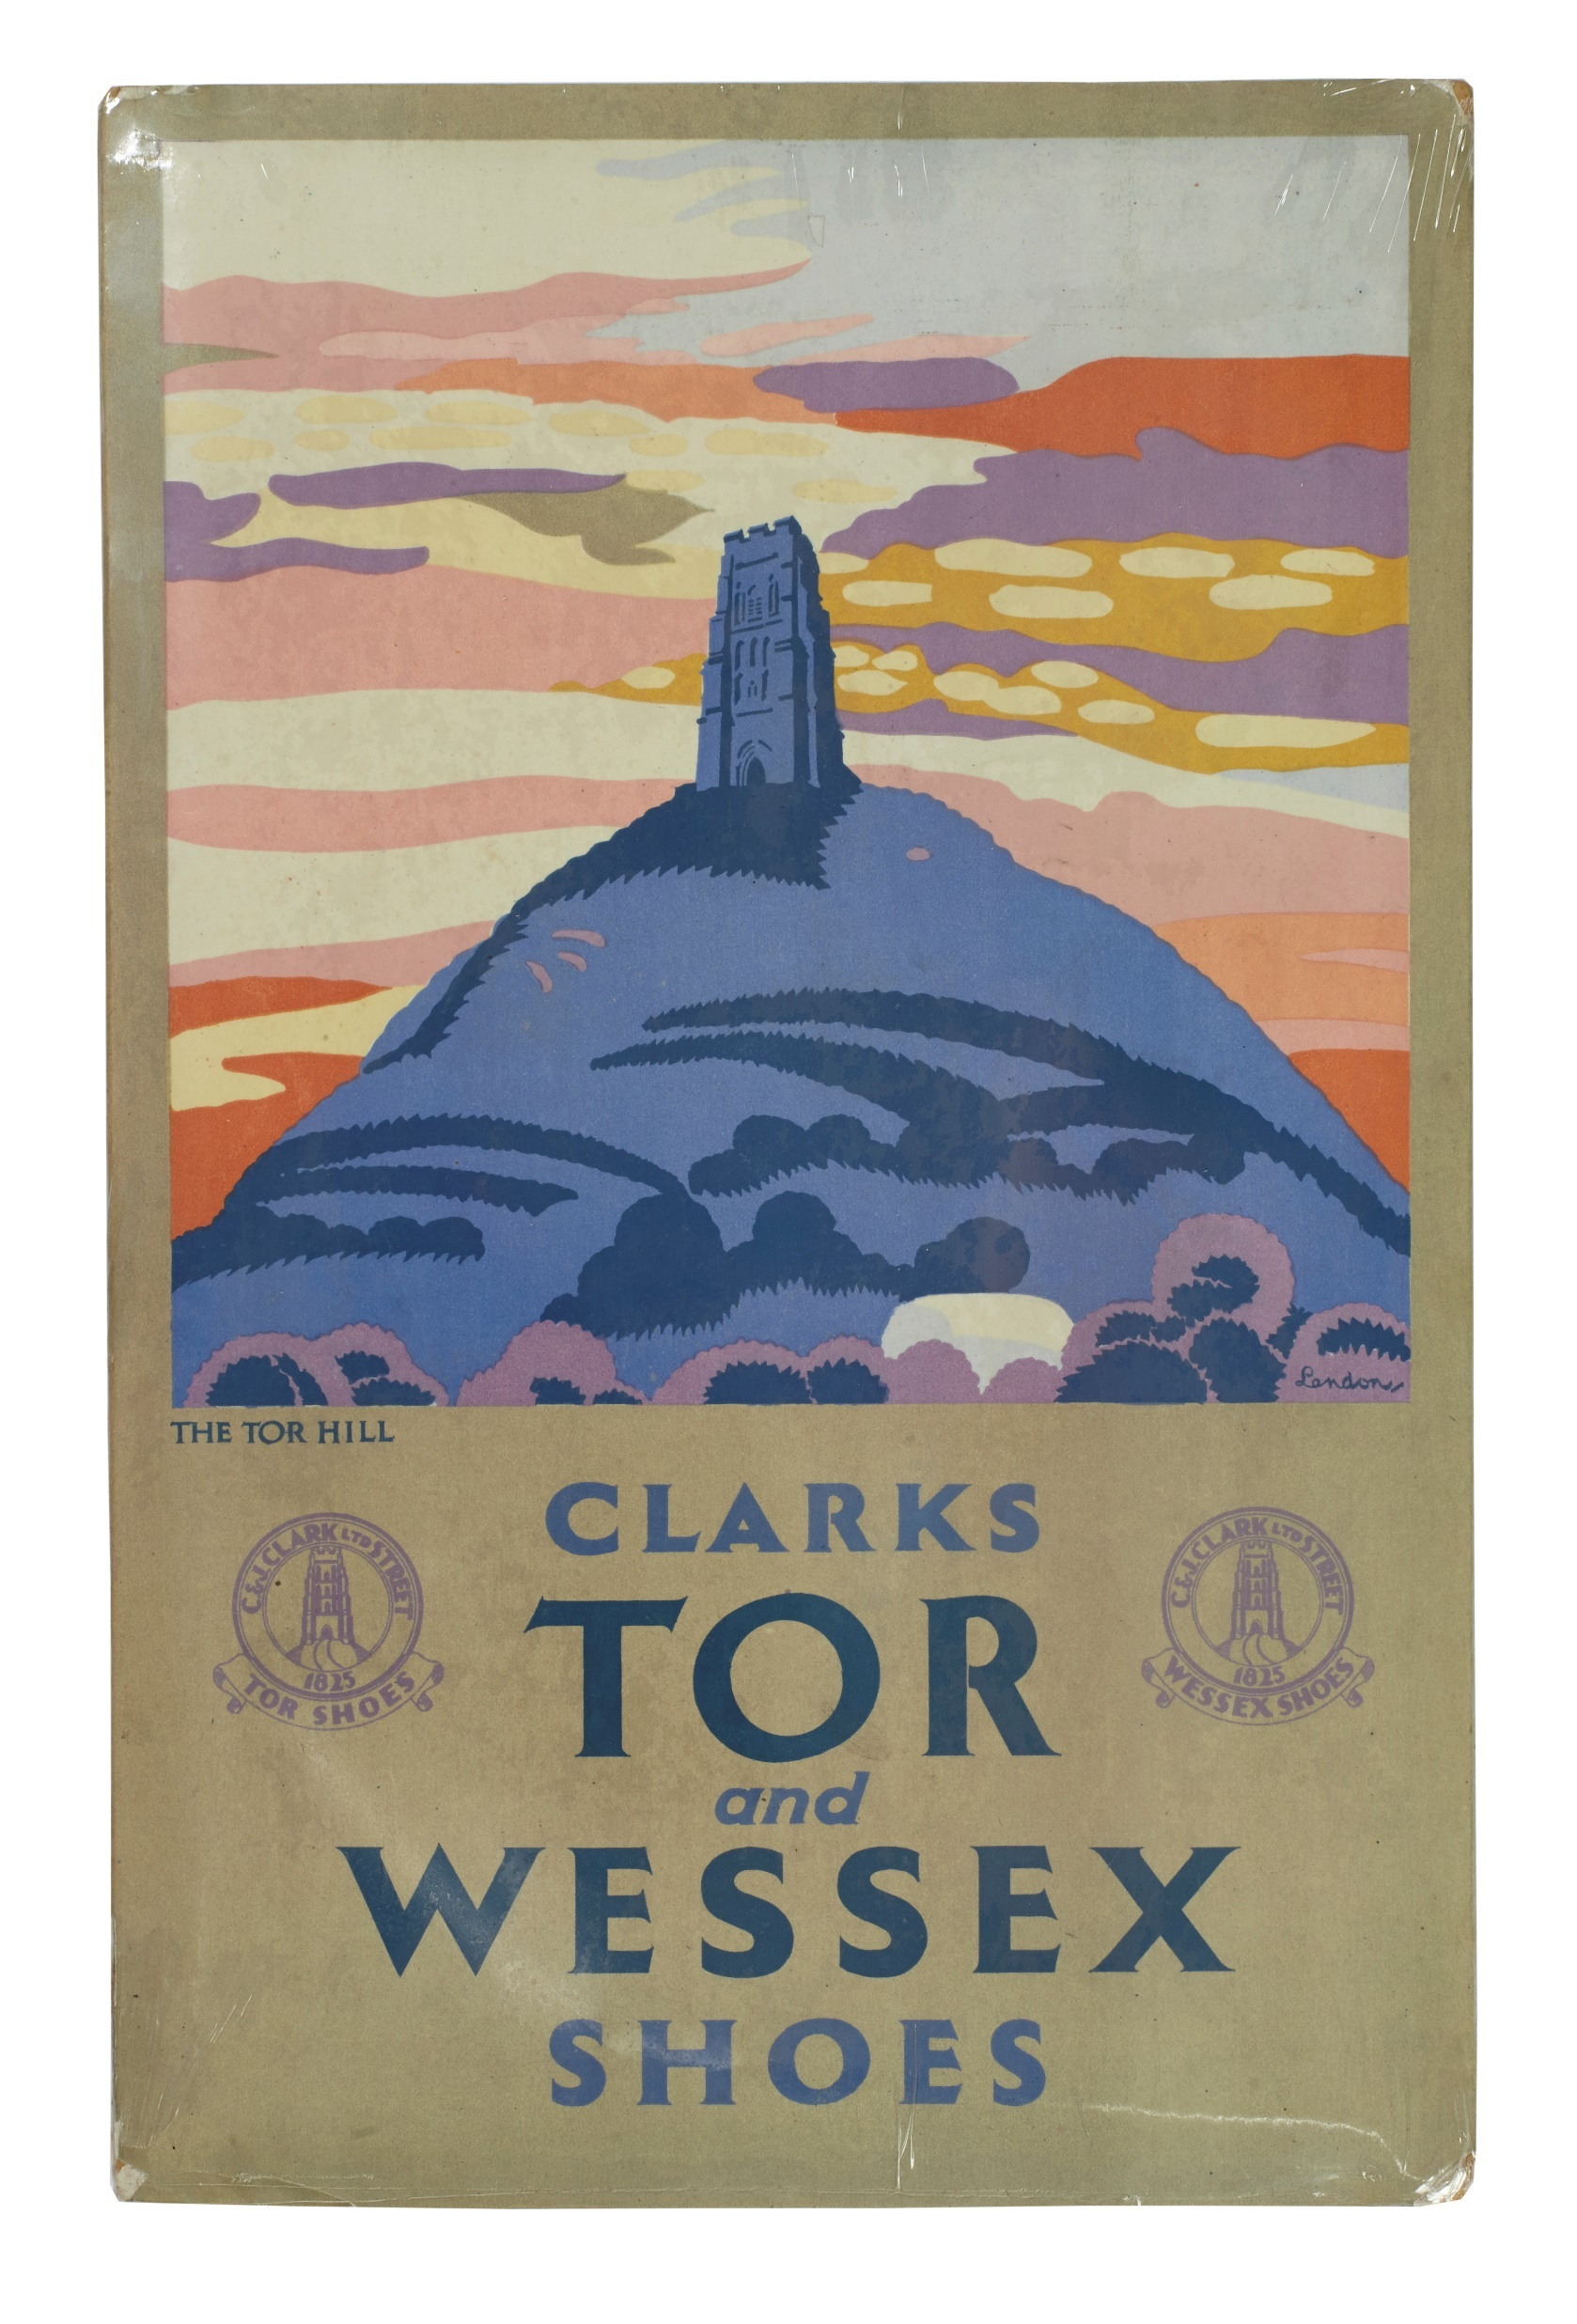
OUR VISION
Our Vision is to inform and inspire the public by sharing the cultural history of shoemaking.
Notes:
Our vision is the mission statement, but smaller. It encompasses everything we want for us as a Trust and where we will go moving forward.
Our vision is to inform and inspire the public by sharing the cultural history of shoemaking.

Slide 7
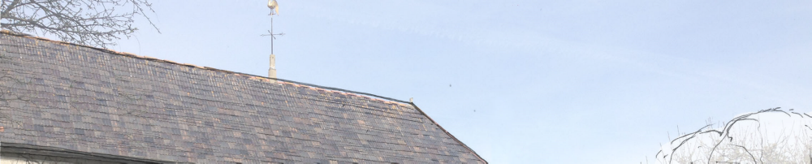
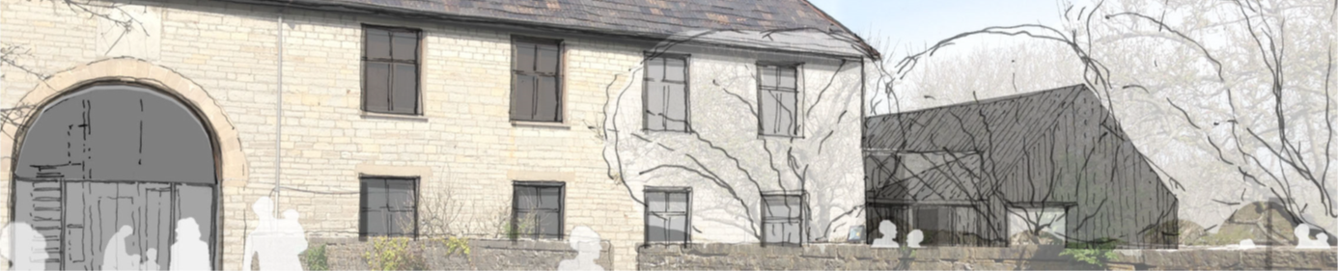
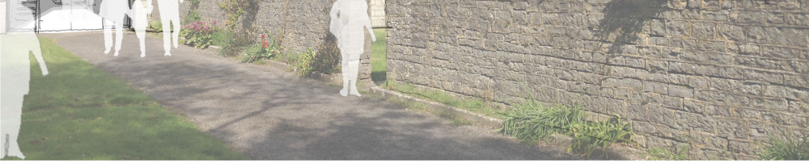
THE FUTURE
A new contemporary museum will be developed on the Grange site for delivery in 2021.
Notes:
There is in place a capital development programme which will be delivered in numerous phases: The first phase will see the development of a children’s museum and visitor attraction, incorporating an exhibition and museum space, storytelling and education areas, café and soft play. The target audiences will be 5-12 years; these spaces will encourage active play and is intended for LEARNING INSPIRATION ENJOYMENT.
Later phases will introduce the development of the wider Grange site building a new link between the Barn/Children’s Museum and the main house which will be a museum, education and outreach space showing the history of the area and the shoe making profession. All of the phases will be delivered and open to the public by 2021.

Slide 8
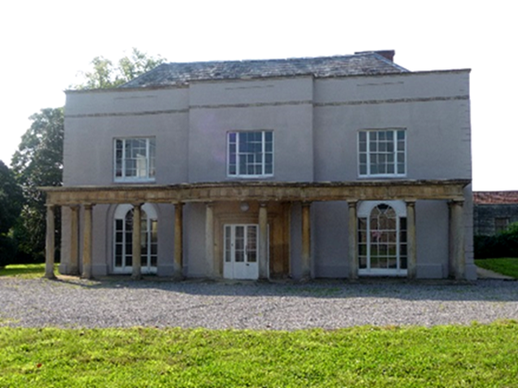
THE FUTURE
The museum will become a popular visitor attraction in the area and an outreach and educational resource.
Notes:
The museum will house a number of significant collections and is hoped to become a popular visitor attraction in the area and an outreach and educational resource.
It is hoped our audience will be broad, including, but not limited to: children and families, researchers, specialist interest groups, historians, students and community groups.

Slide 9
THE BRIEF
Design a new brand for the Trust drawing on the rich history of our collections and our intentions for the future.
The winning logo will form the basis of the Trust’s branding guidelines.
Things to remember:
The branding should reflect the Trust’s Mission, Vision and Values.
The branding should work well both online and offline.
Final versions of the new logo should be submitted in vector formats.
Notes:
We have tried to leave the brief as open as possible -
And this is to encourage innovation and creativity – we do not have a colour scheme preference, although there are a few things to take into consideration – and there are some great articles online or otherwise about this sort of thing –
it is important to think about how the psychology of colour is a crucial part of any museum branding, and around 85% of consumers consider it to be a primary influencer.
For example, red often represents passion and energy, yellow represents warmth, green hints at sustainability, purple oozes luxury and black and blue often symbolise professionalism and authority.
Think about accessibility – it has to be readable and accessible for people with visual impairment and people who are dyslexic – so nothing too complicated.

Slide 10
THE BRIEF
WHAT TO INCLUDE:
Full Colour
Monochrome
Thumbnail, Small, Medium and Large
New logo with our vision
Graphic only
Template powerpoint slide
Template letter head
Notes:
Your aim will be to increase the visibility of the Trust and create a positive perception within the community, the logo and branding touchpoint will help kick start our public image.
Our USP is the sheer volume of objects we have in our custody – we have over 20,000 objects in the point of sale collection, 25,000 in the footwear collection and in total over 100,000 objects. The collections have a local focus but can be viewed in a global context.
It will be used in emails, letter heads so has to be eye catching, obviously, but also, in time, recognisable as ours.
Even though we work a lot with Clarks, it can't have anything to closely linked to the company – we are a completely different entity and that as to be clear, so the Clarks font definitely can’t be used, or Clarks green – which would also be a breach of copyright.
If you were going to use a combination of graphics and text – think about how they would look separately ?

Slide 11
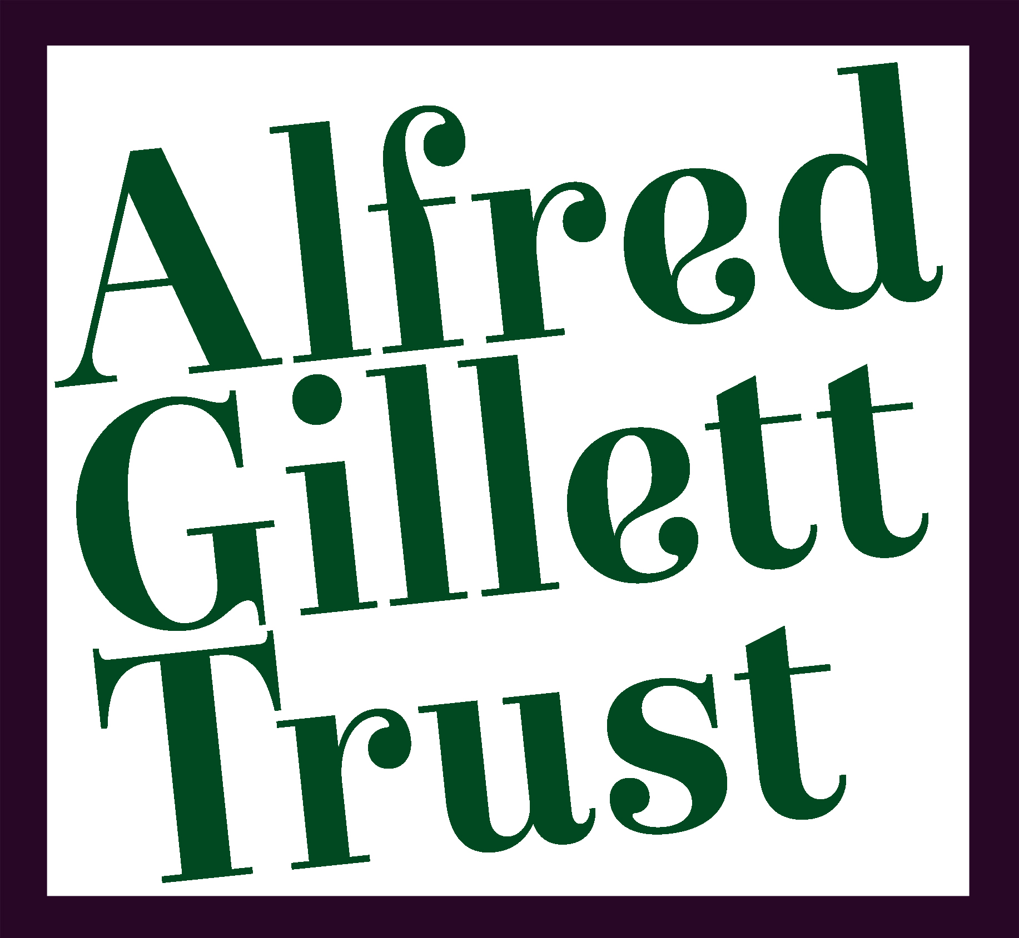

OUR BRAND SO FAR…
Notes:
These are the logos that we have at the moment.
The first one is something that uses Clarks script, which we wouldn’t want to use or be able to. The second once again associates the Trust with Clarks as the two shoes in the image is the children’s ‘Joyance’ sandal and the ‘Desert Boot’. These two are iconic styles in the Clarks ranges and instantly recognisable. Once again we would want to move away from shoe specific imagery as it doesn’t truly reflect the diversity of our collections. It also links us too closely with the company.
For a very long time the AGT has been misconstrued as either part of the company or specifically the Clarks Archive, and whilst a large majority of our collections are company specific, the collection that isn’t, deserves to have a voice to.

Slide 12
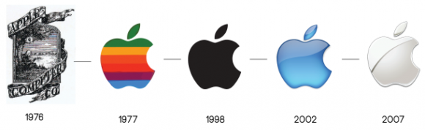
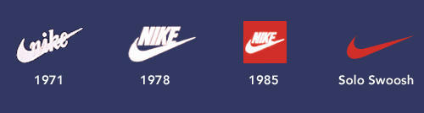
Branding through time
Notes:
Your design will form the basis of the Trust’s branding guidelines. As you can see branding can evolve and change over time. And it is something to perhaps keep in mind when designing – that your design will inevitably change, and grow and evolve with the Trust.

Slide 13
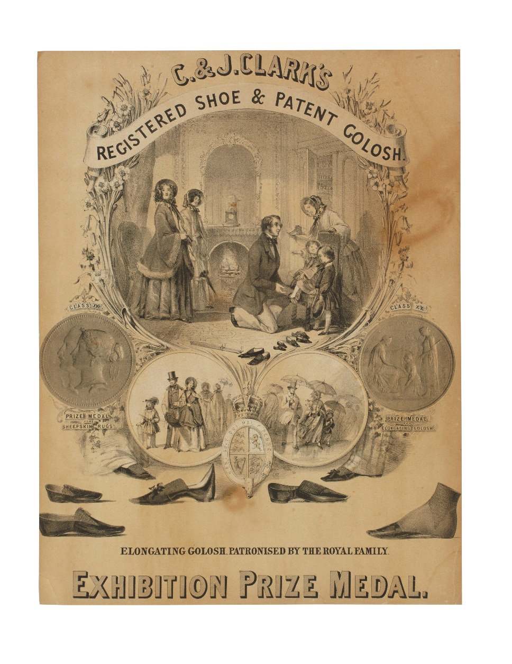
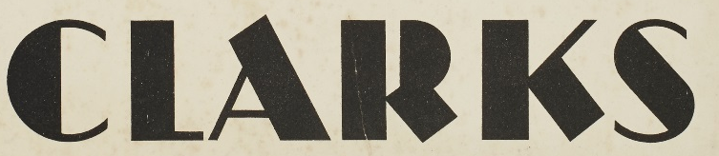
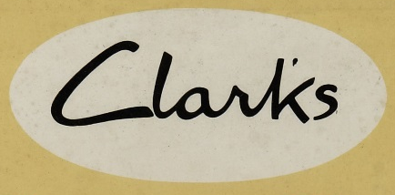
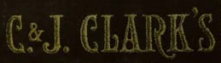
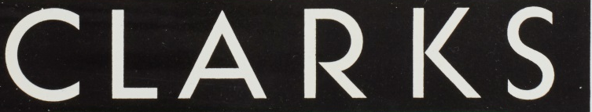
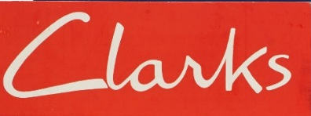
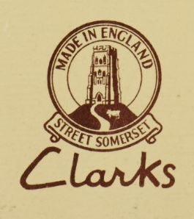
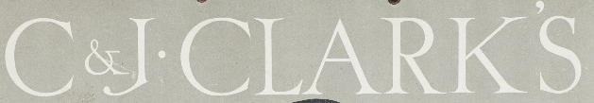
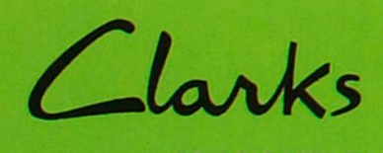
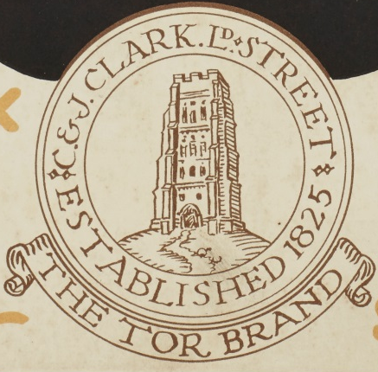
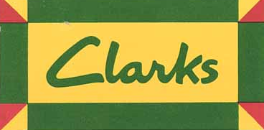
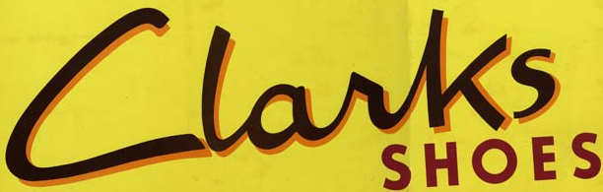
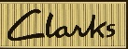
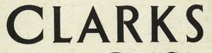
Clarks - Branding through time –
Point of Sale Collection
1851
1931
1946
1905
1934
1957
1913
1961
1925
1929
1939
1985
Notes:
Using one of our main collections; the point of sale – we want to inspire and give you an insight into how Clark’s brand has changed over time and how through their advertising and marketing they have targeted certain audiences.
These are all things to keep in mind when designing for this competition.

Slide 14
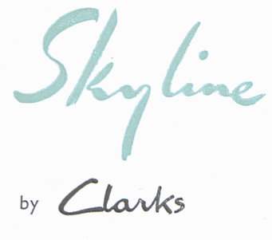
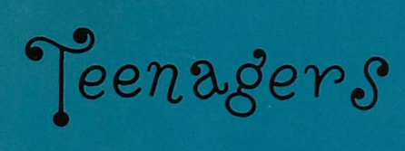
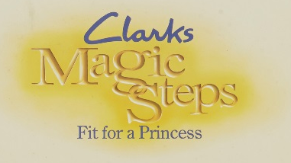
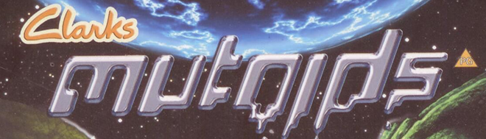
Clarks - Branding through time –
Point of Sale Collection
1939
1952
1960
1988
2003

Slide 15

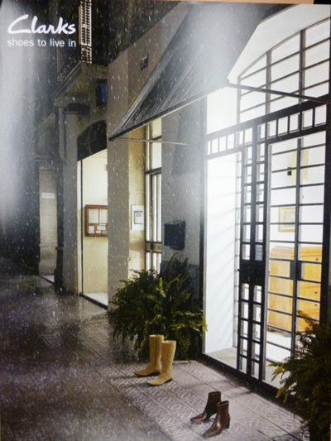
Clarks - Branding through time –
Point of Sale Collection
1851
1957
2004
Notes:
Don’t be afraid to use mixed media; it doesn’t have to be all done on the computer… Some of the most well known images from Clarks Point of sale have been hand drawn illustrations.

Slide 16
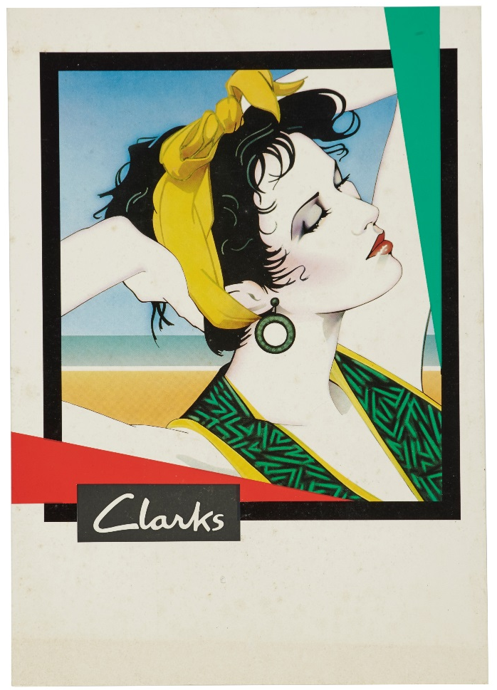
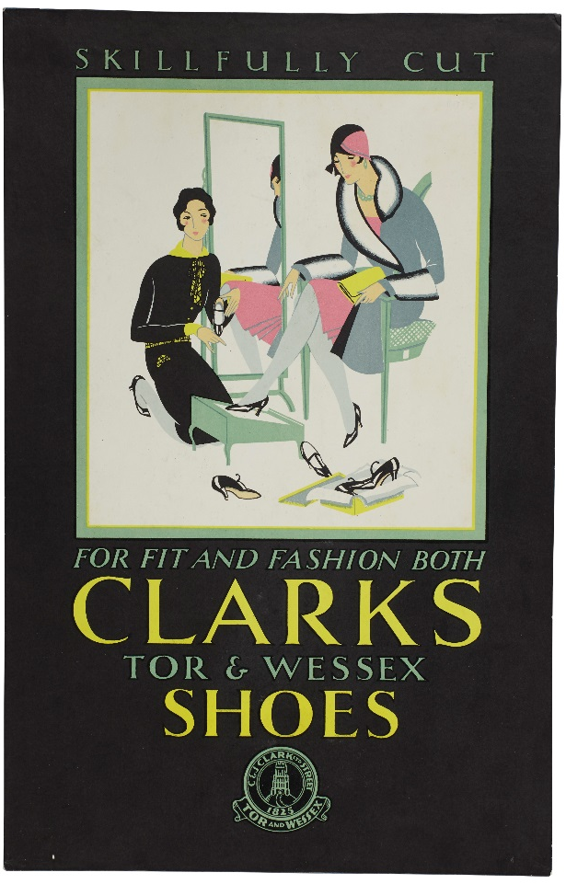
Design Stylisation
Target Audience
1930
1986
Notes:
These are specifically targeted for women, and are typical of the designs/typography/techniques of their decade.
The one on the right was designed by an illustrator Syd Brak who was known to be the most popular poster designer in the 80’s, selling through a company called Athena and was famous for his air brush technique, which epitomises the 80s with the New Romantics.
Something to keep in mind, that the logo has to stay contemporary looking, and not age – or not age too badly!!

Slide 17
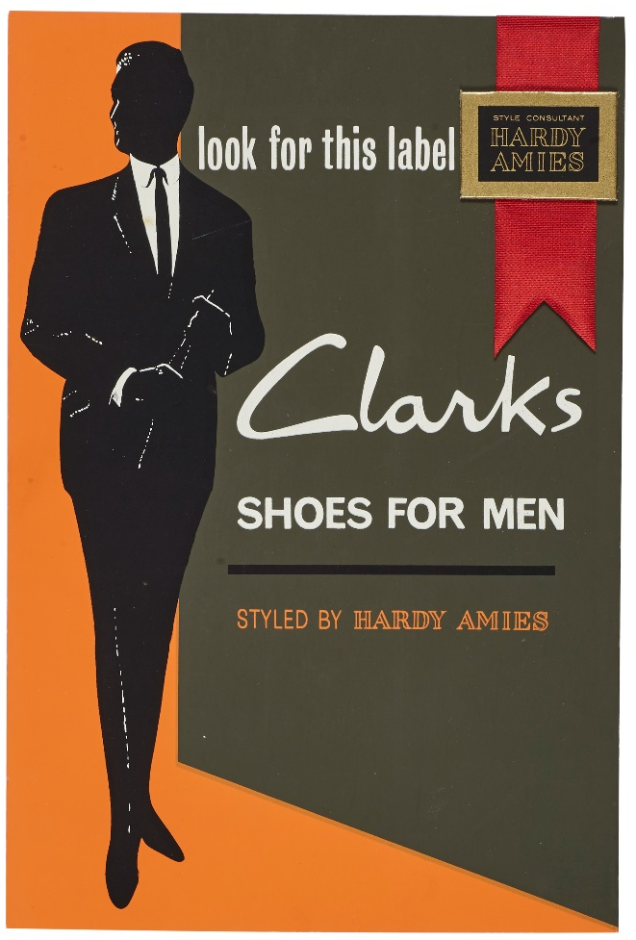
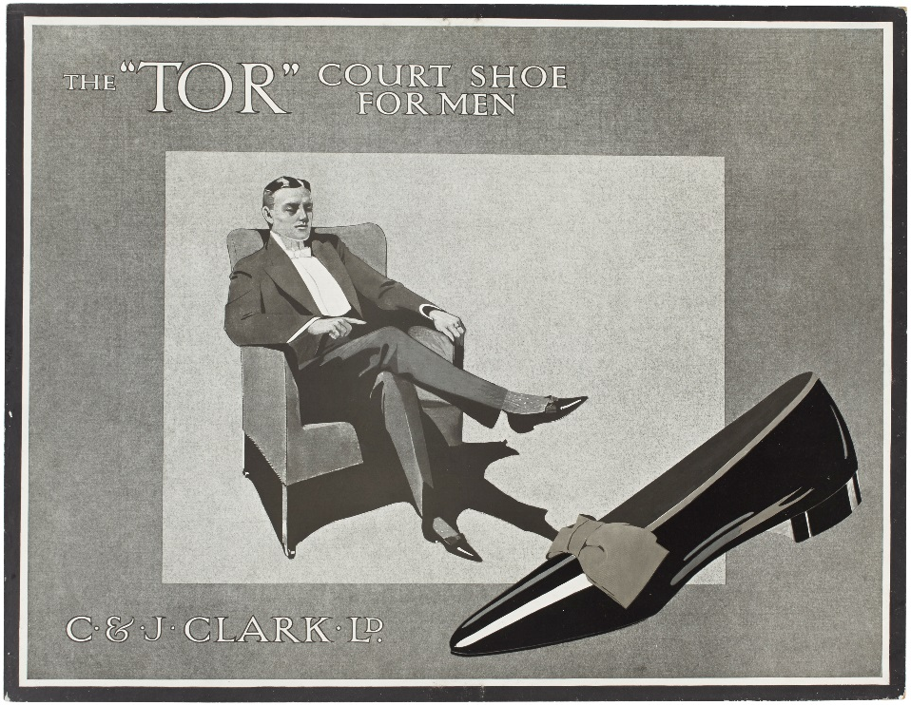
Design Stylisation
Target Audience
1913
1963

Slide 18
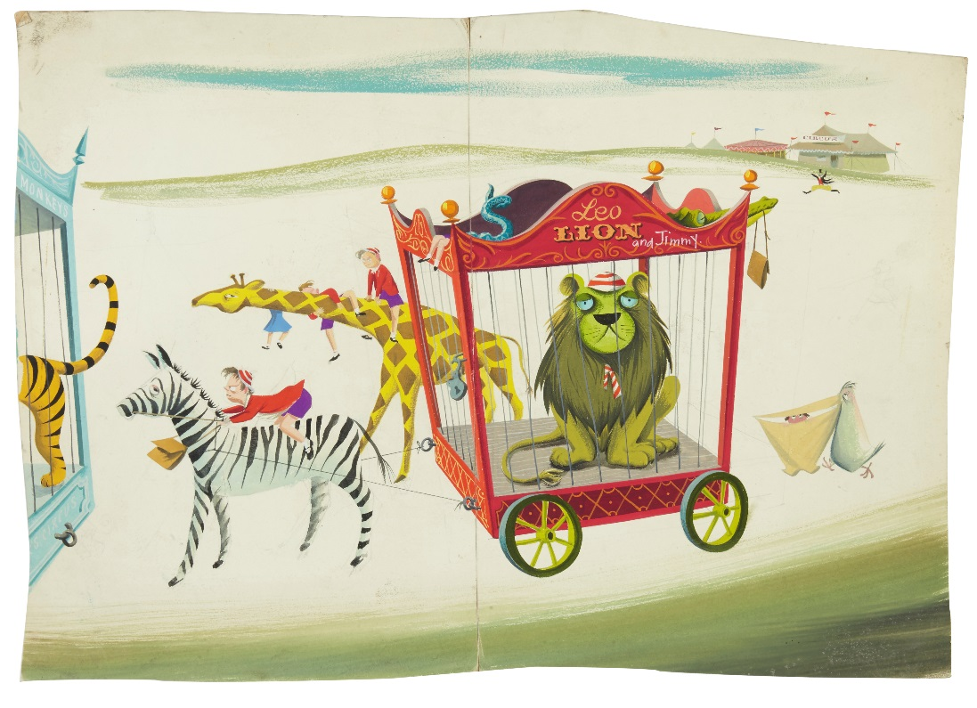
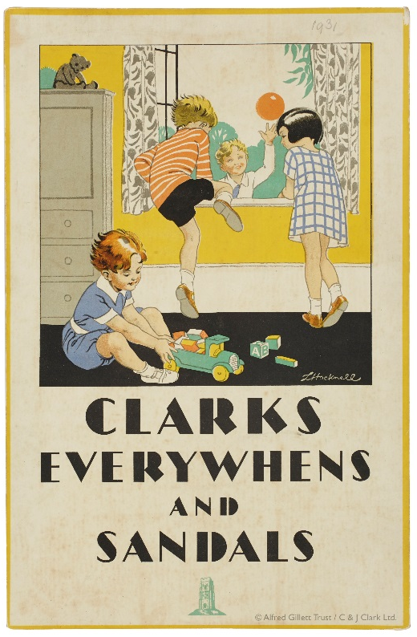
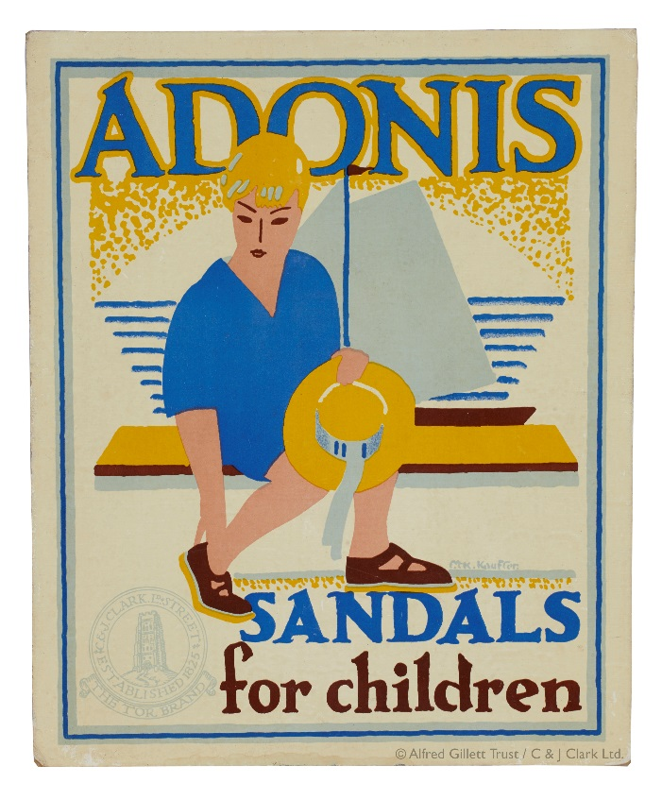
Target Audience

Slide 19
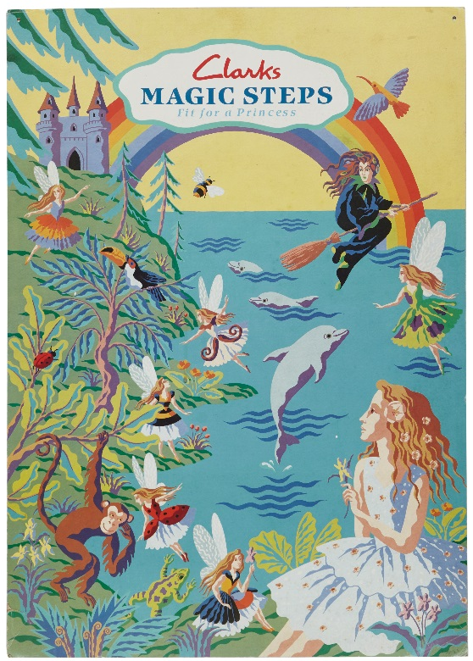
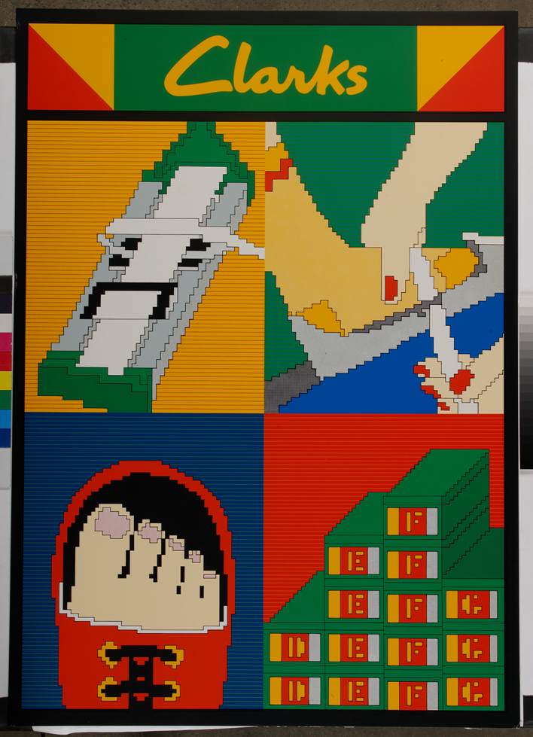
Target Audience

Slide 20

Target Audience

Slide 21




Creative Collaborators
DAVID BAILEY
HELMUT NEWTON
RIAN HUGHES
HARDY AMIES
MARY PORTAS
ORLA KIELY
Notes:
I’d just like to share a few exciting collaborations Clarks have had in the past. They have worked with Sir Ranulph Fiennes, the noted writer, and explorer who promoted a walking sandal for them.
David Bailey and Terence Donovan, two of the three fashion photographers who were integral with documenting ‘The Swinging Sixties’.
Helmut Newton, a notorious fashion photographer, famed for his highly sexualised work shot the Originals campaign
Rian Hughes has not only worked on Bootleg and Friends Together campaigns for Clarks, he is one of the main illustrators for DC and Marvel comics and merchandise.
Mary Portas, some will remember from her programmes including Mary Portas: Queen of Shops and Mary Portas: Secret Shopper.
Orla Kiely, a London based Irish fashion designer that has been called the Queen of print recently collaborated with Clarks

Slide 22






LOGOS WE LIKE!
Notes:
We have identified these logos as ones that work really well for the brand concerned.
The London transport is instantly identifiable along with the National Trust – these are both well known brands which are already recognised.
The national mining logo was picked because you can clearly see the area of focus for the museum and where it is located.
The Wells and Mendip logo is a really interesting example of contemporary use of imagery to portray a local heritage site – it’s a museum about the mendip hills and the caves below them.
We love the National History Museum imagery – the text is minimal offset by beautiful use of the collections they look after inserted inside the N – this logo works really well because the core design remains the same and identifiable, but it can be changed to reflect different parts of their collections.
Our new brand and logo will be used for everything we produce both internally and externally, it is important that any design can sit comfortably along side any partners we may work with in the future, for example Mendip District Council, Heritage Lottery Fund, Arts Council, so while we wouldn’t want our new brand to be designed in order to complement another, it has to work well with other branding.

Slide 23
THE DETAILS
The competition is open to anyone between the ages of 17-26 years old, who are not currently paid marketing and/or design professionals
The winning design will be used as part of the Trusts formal and informal stationary
The judges decision is final. No correspondence will be entered into.
The Alfred Gillett Trust will own the intellectual property rights of the winning entry

Slide 24

THE FINISH LINE
Entries should be emailed to enquiries@agtrust.org.uk
THE DEADLINE IS: 5pm ON FRIDAY 2 SEPTEMBER 2016
Shortlisted entries will be invited to present their work to a judging panel in October.
All shortlisted entrants will receive a copy of the book ‘Made to Last’ by Mark Palmer
The winning entrant will receive £250,will see their design ‘up in lights’ and be supplied with a credit.

Slide 25








ANY QUESTIONS?

Slide 26


